Slide 1
ATAI
Advanced Techniqueof Artificial Intelligence
ATAI
ChongqingUniversity _{AdvancedTechniqueof}
of Technology Artificial Intelligence
Chongqing University of
Technology
Chongqing University ^{ATAI}
_{of Technology} Advanced Techniqueof
Artificial Intelligence
Chongqing University of Technology
Chongqing University of Technology
A Unified Self-Distillation Framework
for Multimodal Sentiment Analysis with Uncertain Missing Modalities
Code:None
2024.4.28 •ChongQing
—— AAAI 2024
Reported by YaoChen Li
1

Slide 2
ATAI
AdvancedTechniqueof
Artificial Intelligence
ATAI
ChongqingUniversity _{AdvancedTechniqueof}
of Technology Artificial Intelligence
ChongqingUniversity of Technology
Motivation
(1) only perform interactions between fixed modality missing cases and fail to address stochastic real-world scenarios;
(2) focus only on coarse-grained and localized interactions in missing modalities, leading to non-robust joint representations.
(3) fail to remove redundant semantics in multimodal representations, resulting in performance bottlenecks.

Slide 3
ChongqingUniversity of Technology
ATAI
AdvancedTechniqueof
Artificial Intelligence
ATAI
ChongqingUniversity _{AdvancedTechniqueof}
of Technology Artificial Intelligence
Overview
Language--Glove Audio--COVAREP Visual--Facet

Slide 4
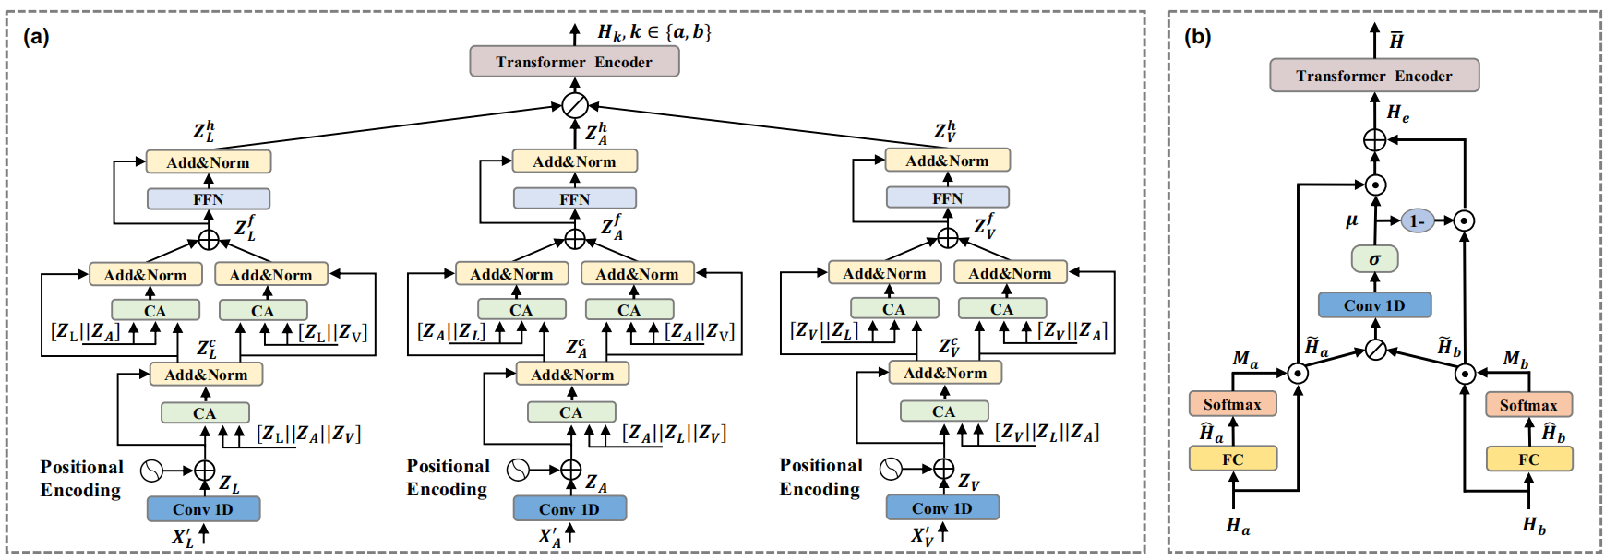
ChongqingUniversity of Technology
ATAI
AdvancedTechniqueof
Artificial Intelligence
ATAI
ChongqingUniversity _{AdvancedTechniqueof}
of Technology Artificial Intelligence
Overview

Slide 5
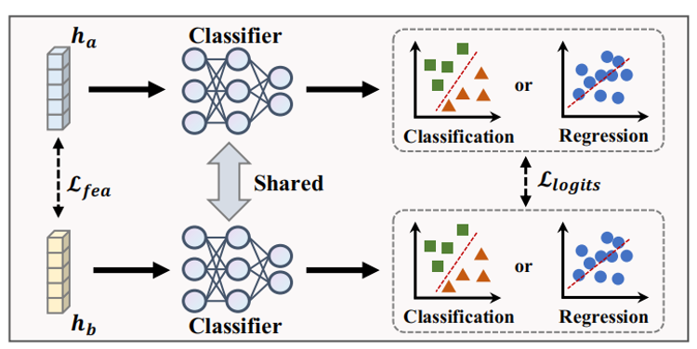
ChongqingUniversity of Technology
ATAI
AdvancedTechniqueof
Artificial Intelligence
ATAI
ChongqingUniversity _{AdvancedTechniqueof}
of Technology Artificial Intelligence
Method

Slide 6
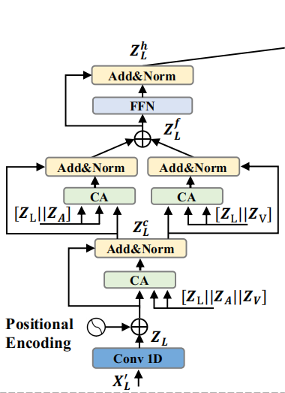
ChongqingUniversity of Technology
ATAI
AdvancedTechniqueof
Artificial Intelligence
ATAI
ChongqingUniversity _{AdvancedTechniqueof}
of Technology Artificial Intelligence
Method
)

Slide 7
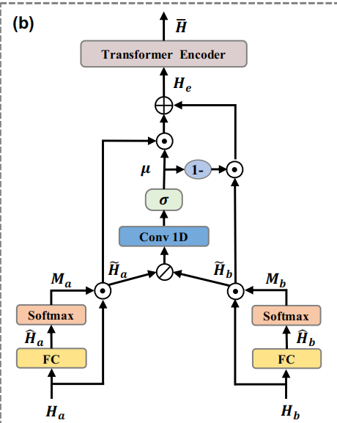
ChongqingUniversity of Technology
ATAI
AdvancedTechniqueof
Artificial Intelligence
ATAI
ChongqingUniversity _{AdvancedTechniqueof}
of Technology Artificial Intelligence
Method

Slide 8
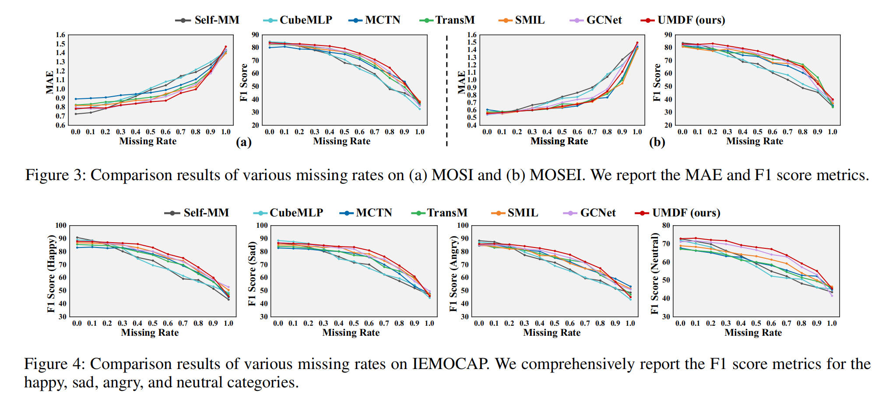
ATAI
AdvancedTechniqueof
Artificial Intelligence
ATAI
ChongqingUniversity _{AdvancedTechniqueof}
of Technology Artificial Intelligence
ChongqingUniversity of Technology
Experiments

Slide 9
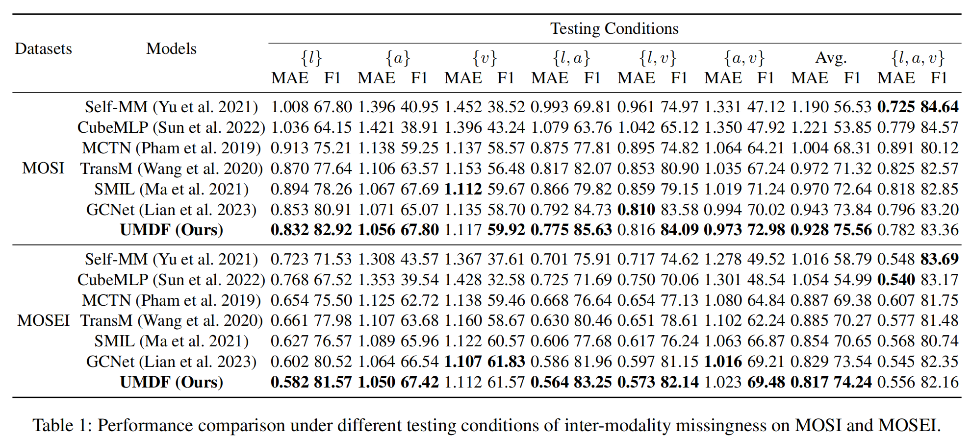
ATAI
AdvancedTechniqueof
Artificial Intelligence
ATAI
ChongqingUniversity _{AdvancedTechniqueof}
of Technology Artificial Intelligence
ChongqingUniversity of Technology
Experiments

Slide 10
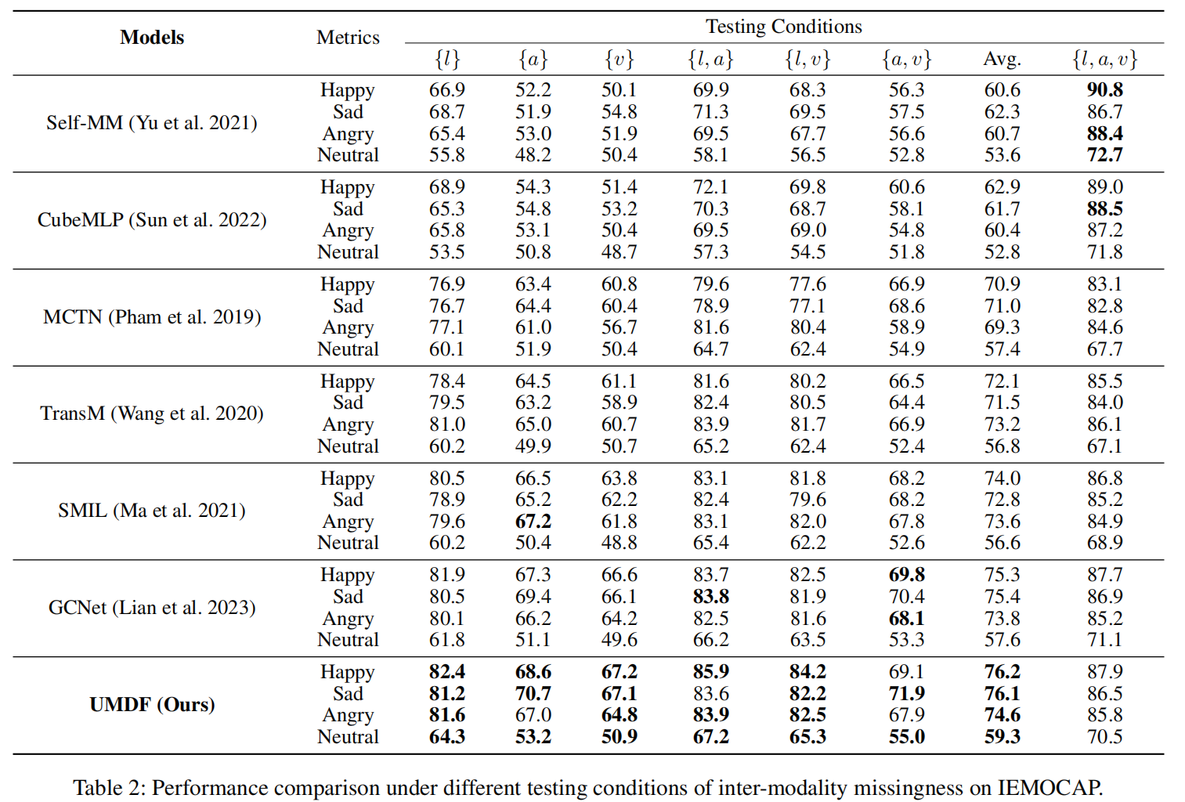
ChongqingUniversity of Technology
ATAI
AdvancedTechniqueof
Artificial Intelligence
ATAI
ChongqingUniversity _{AdvancedTechniqueof}
of Technology Artificial Intelligence
Experiments

Slide 11
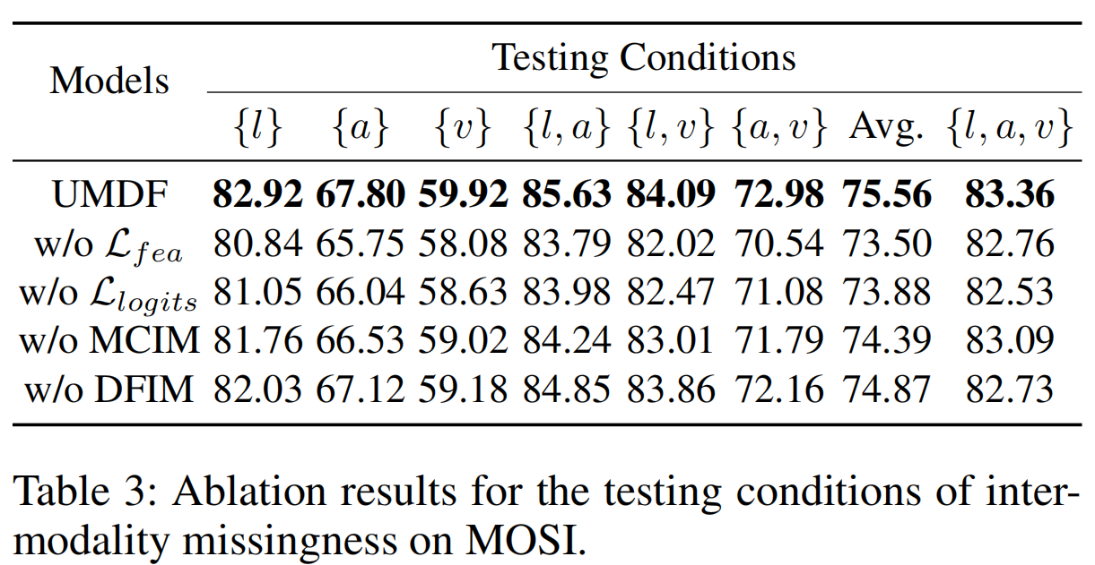
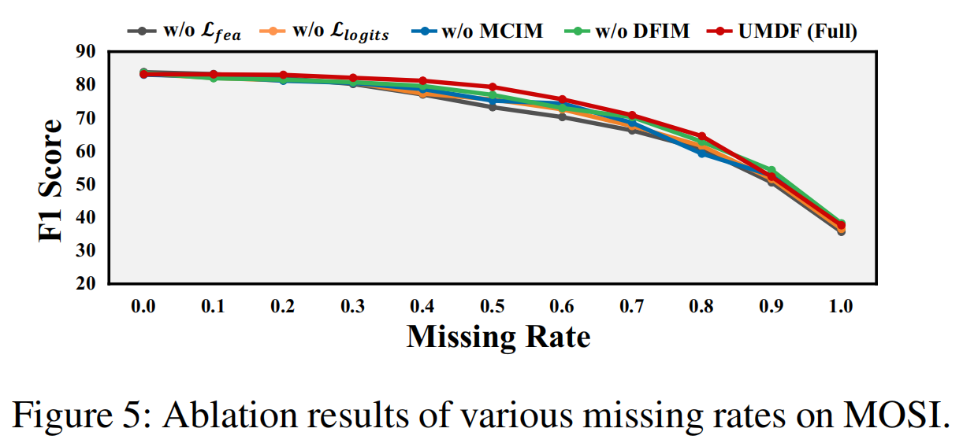
ChongqingUniversity of Technology
ATAI
AdvancedTechniqueof
Artificial Intelligence
ATAI
ChongqingUniversity _{AdvancedTechniqueof}
of Technology Artificial Intelligence
Experiments

Slide 12
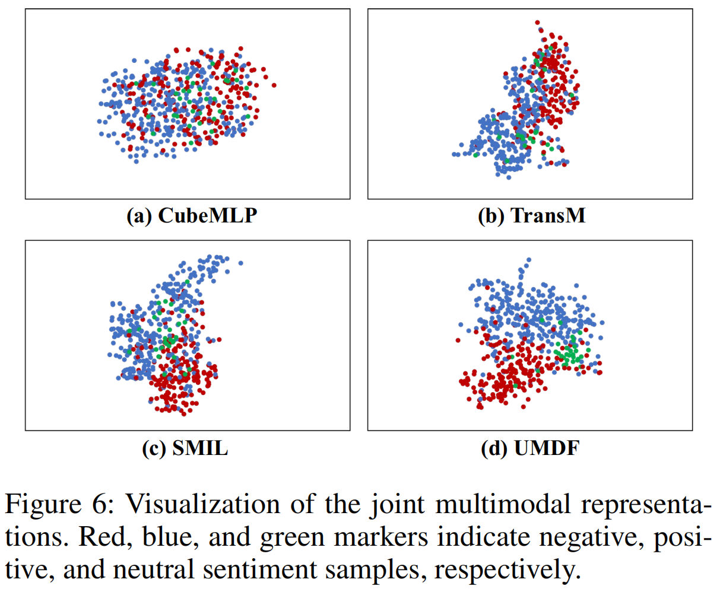
ChongqingUniversity of Technology
ATAI
AdvancedTechniqueof
Artificial Intelligence
ATAI
ChongqingUniversity _{AdvancedTechniqueof}
of Technology Artificial Intelligence
Experiments

Slide 13
ChongqingUniversity of Technology
ATAI
AdvancedTechniqueof
Artificial Intelligence
ATAI
ChongqingUniversity _{AdvancedTechniqueof}
of Technology Artificial Intelligence
Thanks!

